Slide 1
Digital Portfolio
STUDENT NAME:m.mythili
REGISTER NO:astvu36336324u18036
NMID:2514E8298350A359F4D4E503136E9C66
DEPARTMENT: BSC(COMPUTER SCIENCE)
COLLEGE: SREE ABIRAAMI ARTS AND SCIENCE COLLEGE FOR WOMEN/THIRUVALLUVAR UNIVERSITY

Slide 2
PROJECT TITLE DIGITAL PORTFOLIO IN FRONT AND DEVELOPMENT

Slide 3


AGENDA
Problem Statement
Project Overview
End Users
Tools and Technologies
Portfolio design and Layout
Features and Functionality
Results and Screenshots
Conclusion
Github Link
3/21/2024 Annual Review

Slide 4

PROBLEM STATEMENT
1. Problem Statement
A problem statement is a concise description of the issue you want to address. It defines the gap between the current situation and the desired situation. A good problem statement clearly articulates the problem, its significance, and why it needs to be solved.
Key Elements of a Problem Statement:
The Problem: What is the issue? Describe it in specific terms.
The Context: Where and when is this problem occurring? What is the environment in which it exists?
The Consequences: What will happen if the problem is not addressed? Why is it important to solve it?
The Goal: What is the desired outcome? What would a successful solution look like?

Slide 5

PROJECT OVERVIEW
It seems like you're asking for an overview of a project, specifically the front-end and development aspects. Could you clarify a bit more about the project you're referring to? Are you looking for an outline of how to approach both the front-end and back-end development of a project? Or are you referring to specific technologies or tools you'd like to use for front-end and development tasks?

Slide 6

WHO ARE THE END USERS?
In Summary:
Direct end users are people who interact with the app or website, ranging from consumers to internal employees.
Indirect end users might be business stakeholders and designers, whose input influences the experience.
Front-end developers serve as a bridge to bring the needs of the actual end users into reality through their technical work.
Let me know if you need a deeper dive into any of these categories!

Slide 7
GITHUB AND PORTFOLIO:
https://mythilideepa.github.io/mythilimani/

Slide 8

TOOLS AND TECHNIQUES
Popular JavaScript Frameworks:
React.js: A popular JavaScript library for building user interfaces. It focuses on component-based architecture, making it easier to manage complex UIs.
Vue.js: A progressive JavaScript framework for building UIs. It’s lighter and easier to integrate into existing projects compared to React.
Angular: A full-featured JavaScript framework developed by Google. It’s suitable for building large-scale applications and provides many built-in features like routing, forms, and HTTP requests.
Svelte: A newer, innovative framework that shifts much of the work to compile time rather than runtime, which can lead to better performance.
2. Preprocessors and CSS Tools
Sass (Syntactically Awesome Stylesheets): A CSS preprocessor that allows you to use variables, nesting, and functions for cleaner, more maintainable code.
Less: Another CSS preprocessor, similar to Sass.
PostCSS: A tool for transforming CSS with JavaScript plugins. It's often used for things like autoprefixing,

Slide 9
POTFOLIO DESIGN AND LAYOUT
By using html,css,javascript as front end development uing the application as visual studio code and github website
https://mythilideepa.github.io/mythilimani/
9

Slide 10
FEATURES AND FUNCTIONALITY
Accessibility (a11y)
Semantic HTML for screen readers.
Keyboard navigation.
High-contrast themes & ARIA roles.
API Integration
Fetching & displaying data from REST or GraphQL APIs.
Authentication flows (JWT, OAuth, cookies/sessions).
WebSockets for real-time data (chat apps, live dashboards).
Security Features
Input sanitization (preventing XSS).
HTTPS & secure cookies.
CSRF protection in forms.

Slide 11
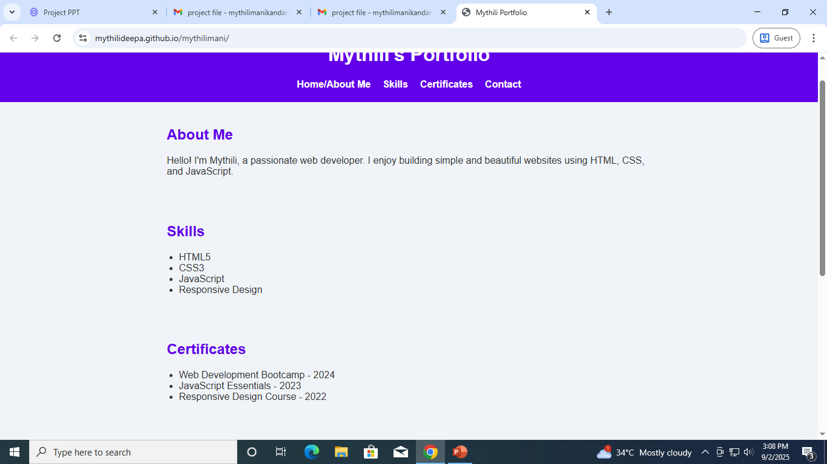

RESULTS AND SCREENSHOTS
3/21/2024 Annual Review
11

Slide 12
CONCLUSION
Writing structure (e.g., writing the conclusion at the beginning before the development of ideas, like in deductive essays or journalistic writing),
Business/Project planning (where the vision or conclusion is stated first, then development steps are outlined),
Or something else (like software development, scientific method, or speech writing)?
In general writing, “conclusion in front and development” usually refers to the deductive structure:
Conclusion in front → You start with the main point, thesis, or result.
Example: “The new system will reduce costs by 20%.”
Development → Then you present supporting evidence, analysis, or reasoning that develops and explains why the conclusion is valid.
Example: cost breakdowns, workflow improvements, case studies, etc.
12

